Slide 1
Hunger Express
Presentation On Class Diagram
CSE-326
Group: 4 (A2)
1705031
1705034
1705041
1705049
1705054
1705059
1505048

Slide 2
User Interface
There are total 8 modules in our project
Customer module
Menu/Cart module
Order module
Review module
Coin module
Restaurant module
Promo module
Vat/Address module

Slide 3
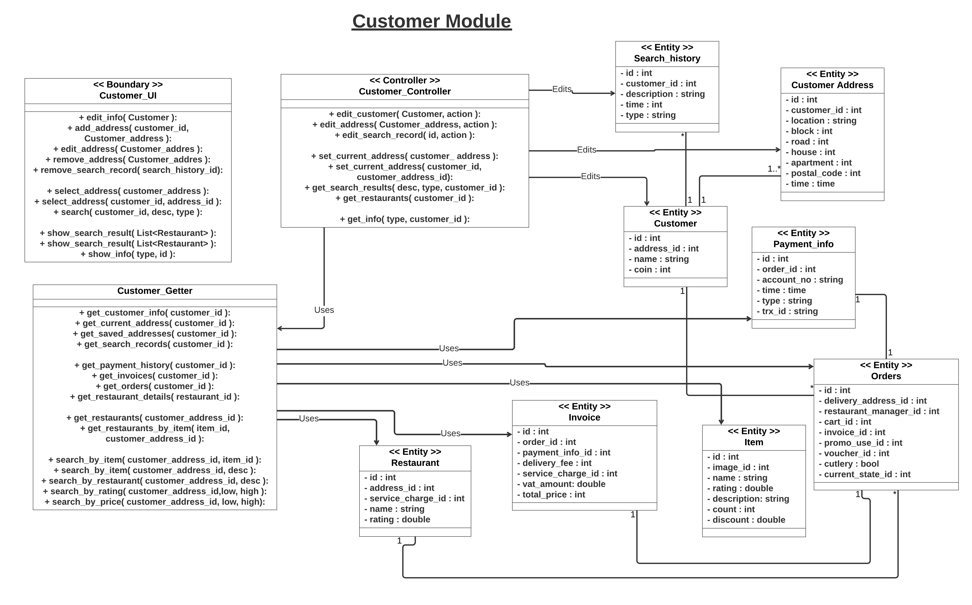

Slide 4
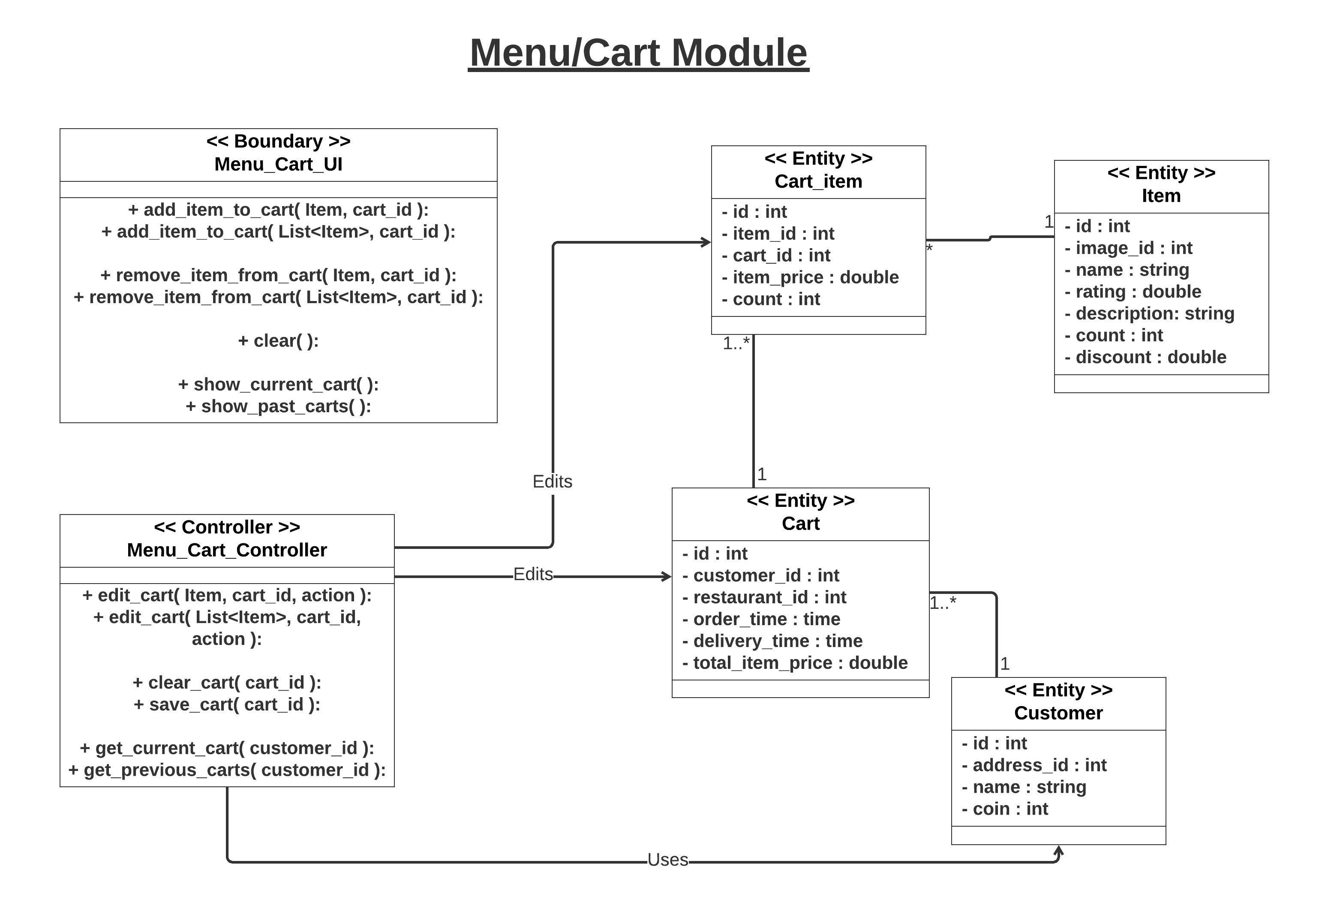

Slide 5
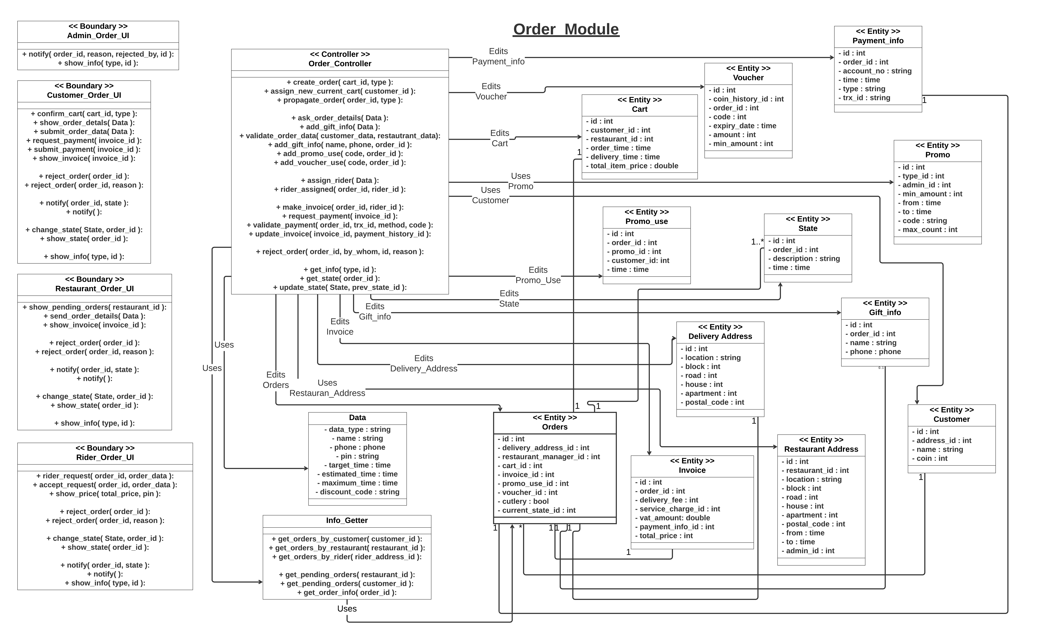

Slide 6
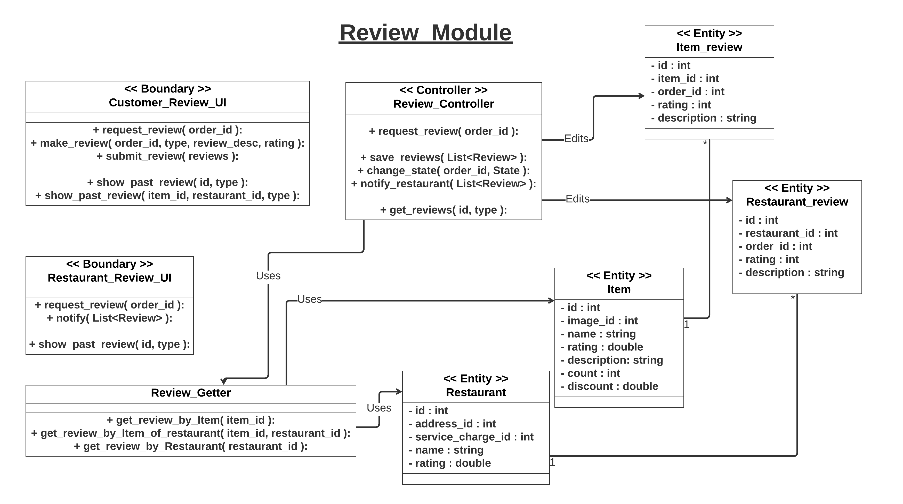

Slide 7
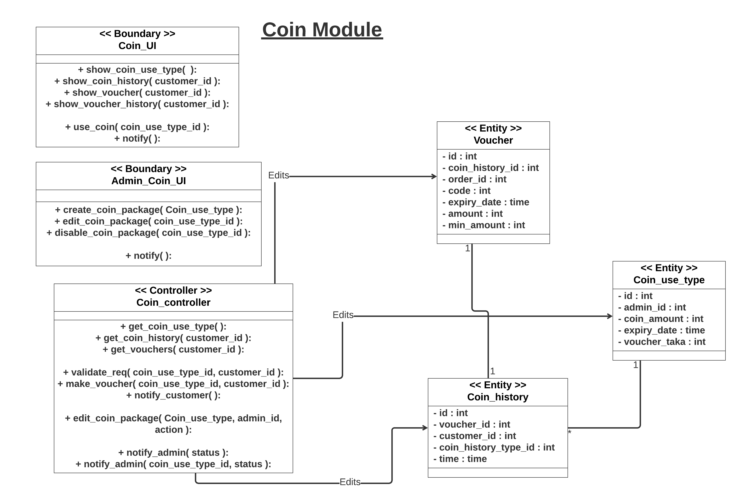

Slide 8
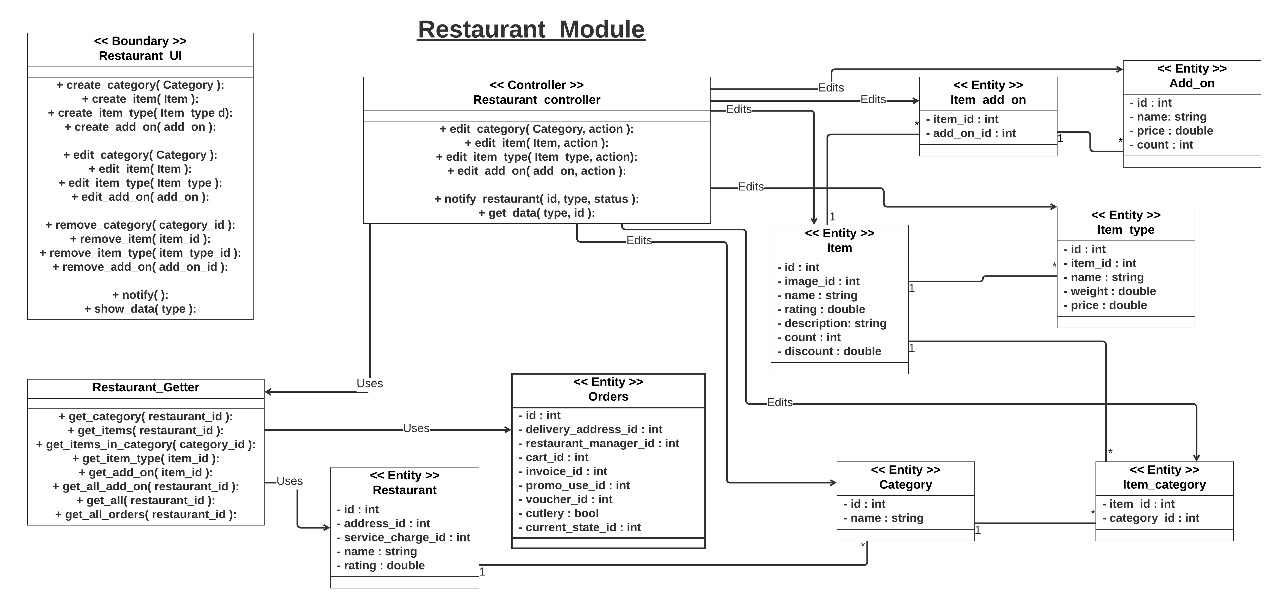

Slide 9
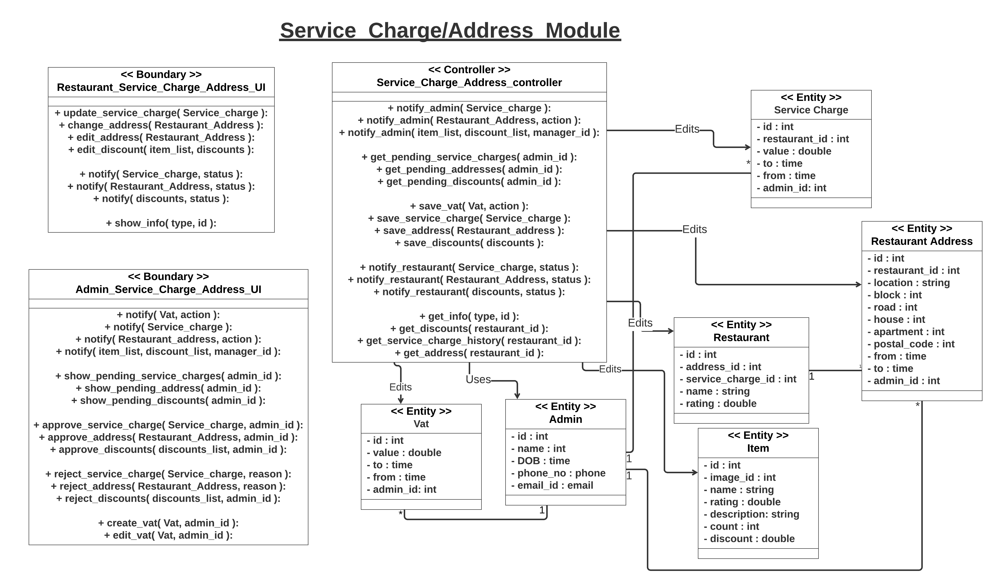

Slide 10
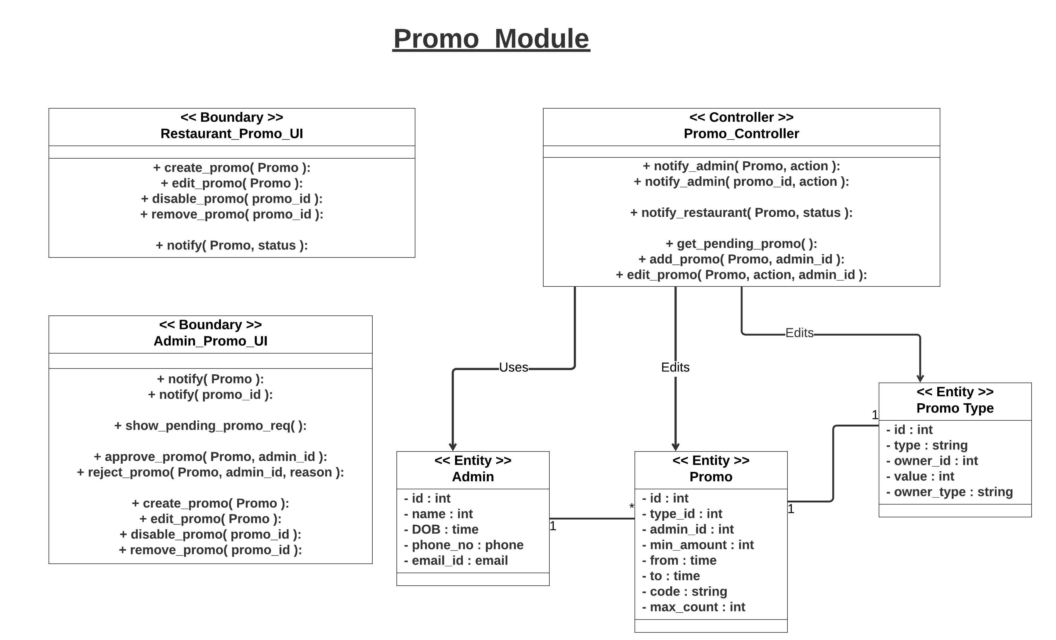

Slide 11
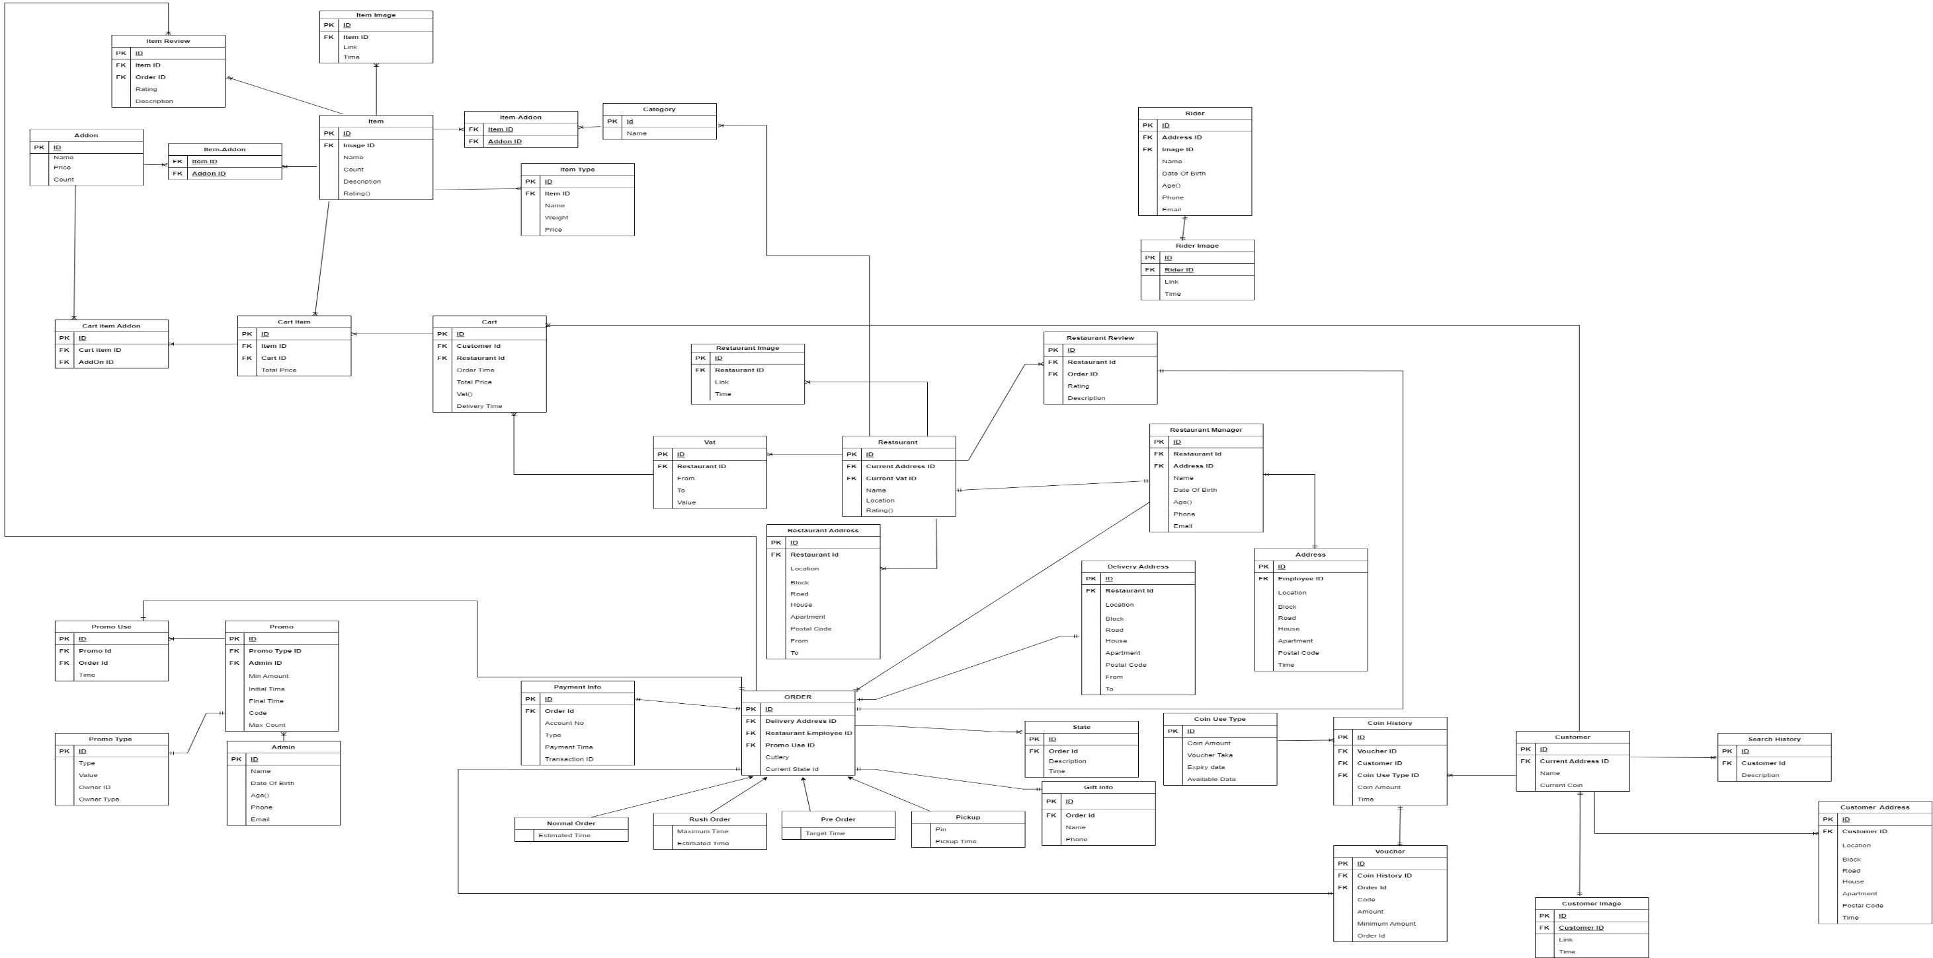
The ER Diagram

Slide 12
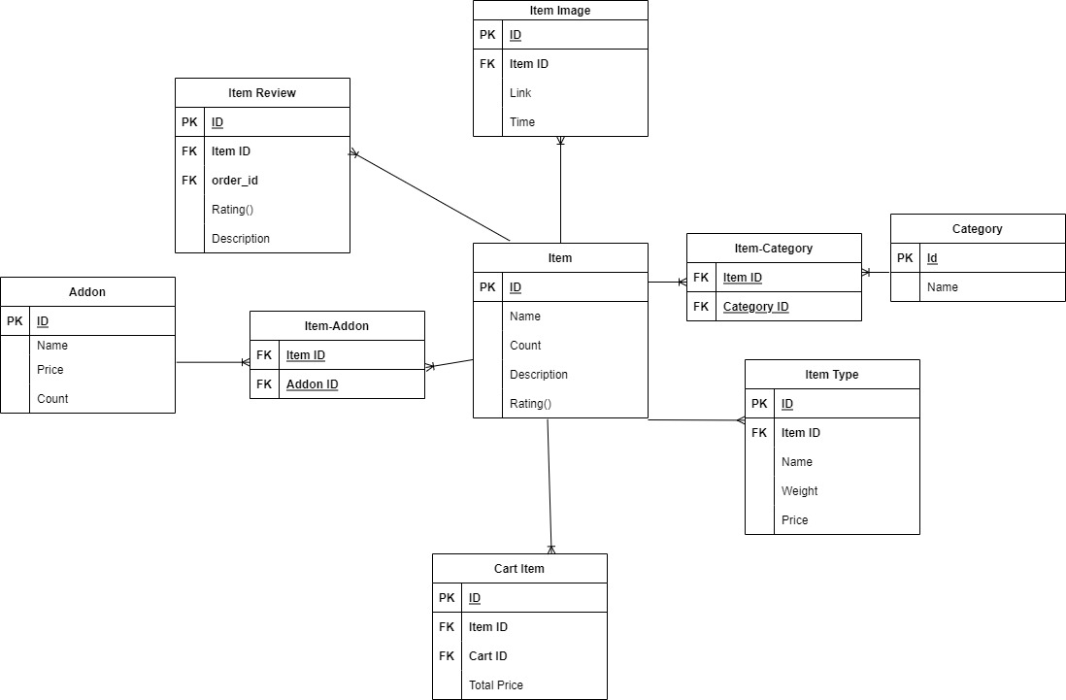
Item Module

Slide 13
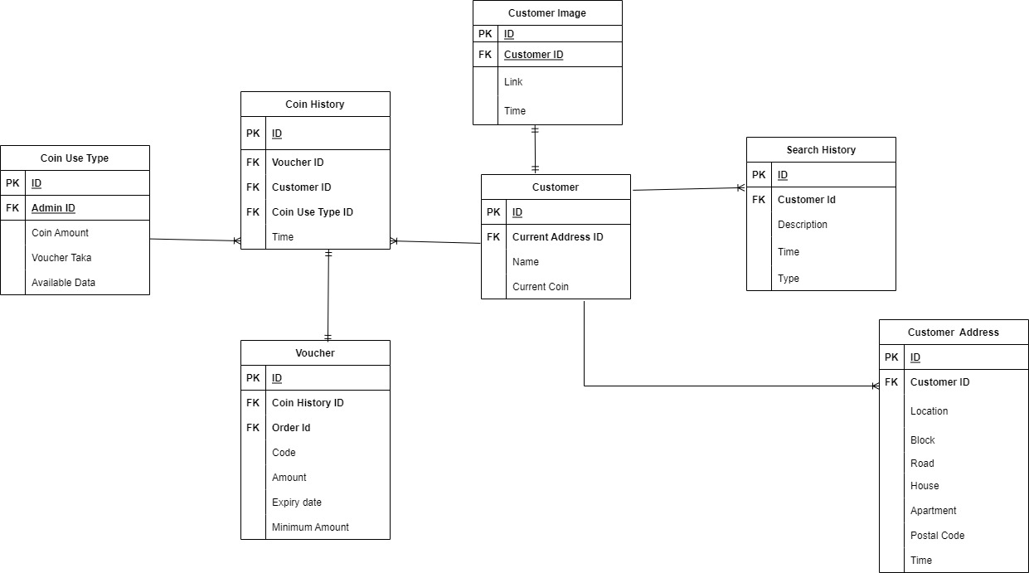
Customer Module

Slide 14
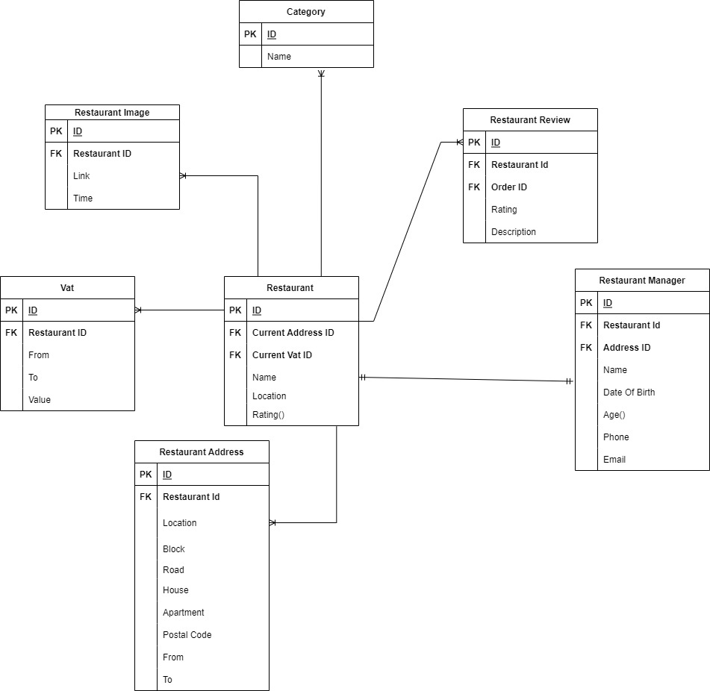
Restaurant Module

Slide 15
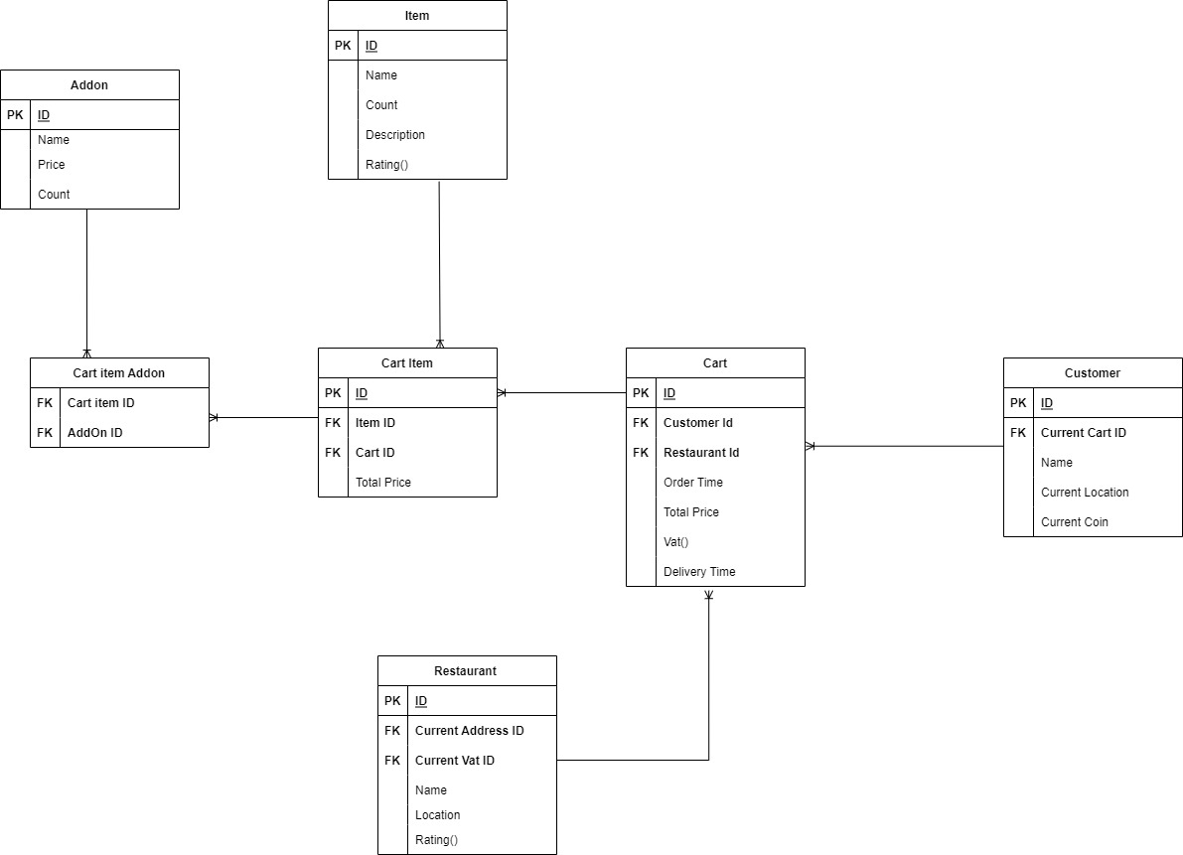
Cart Module

Slide 16
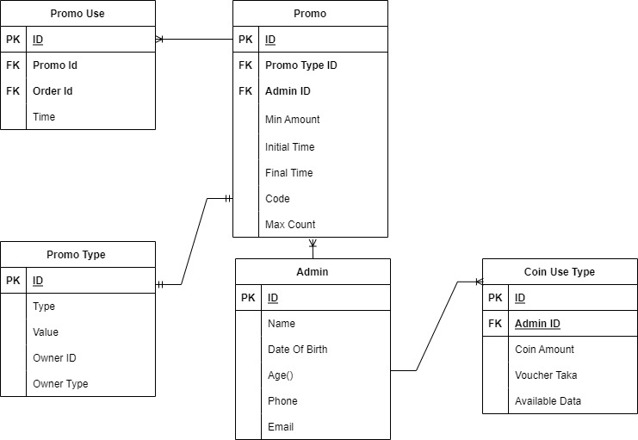
Promo Module

Slide 17
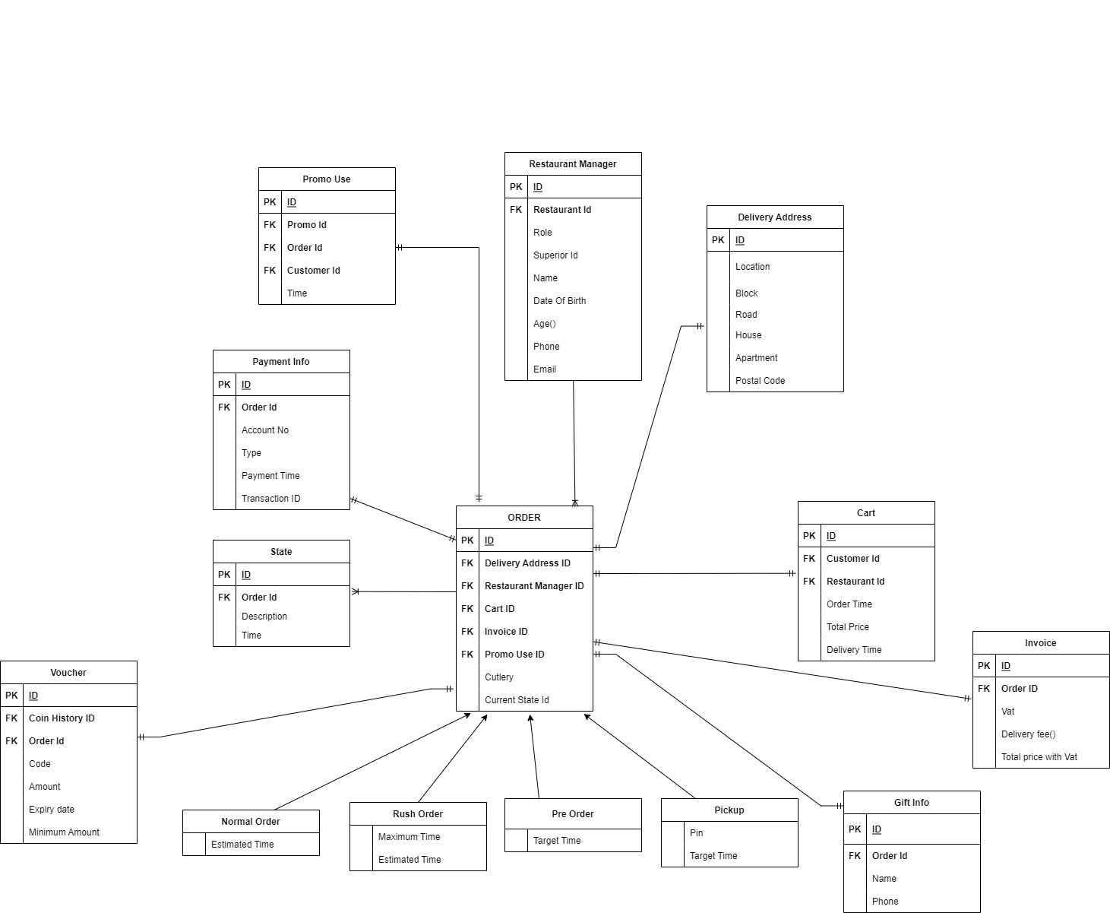
Order Module

Slide 18
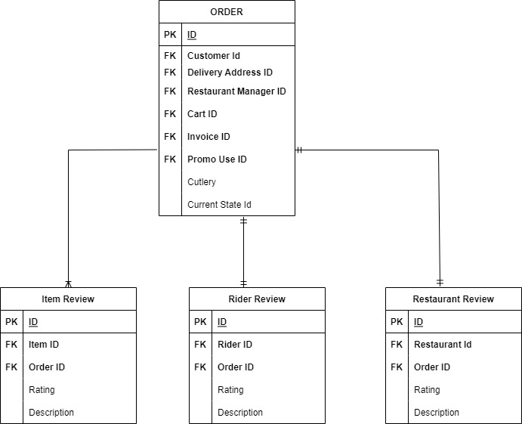
Review Module

Slide 19


